Slide 1
AI/ML Internship Final Project
AI-Based Virtual Try-On and Fashion Recommendation System
LOYA PRANAY
AI/ML Intern
Raritone Summer Internship 2026
Date: 05-06-2026

Slide 2
Table of Contents
Project Overview
Objectives
Technologies
Computer Vision
Pose Estimation
Body Measurements
Datasets
Virtual Try-On
3D Avatar
Recommendation System
AI Workflow
Challenges
Skills
Future Scope
Conclusion
This follows the uploaded reference presentation.

Slide 3
Project Overview
Artificial Intelligence is transforming the fashion industry by enabling personalized shopping experiences through Virtual Try-On systems and AI recommendation engines.
This internship focused on researching and understanding the technologies required to build an intelligent AI-powered fashion platform.
Major Research Areas
•Computer Vision
• Body Segmentation
• Pose Estimation
• Body Measurement Extraction
• Virtual Try-On
• AI Recommendation Systems
• 3D Avatar Generation

Slide 4
Objectives
Study Artificial Intelligence applications in fashion.
Understand Computer Vision fundamentals.
Explore body segmentation and pose estimation.
Research Virtual Try-On architectures.
Analyse fashion datasets.
Study garment warping techniques.
Explore AI recommendation systems.
Design a complete AI workflow.

Slide 5
Technologies and Tools
Programming
Python
OpenCV
MediaPipe
TensorFlow
Development Tools
Visual Studio Code
GitHub
AI Frameworks
Detectron2
DeepLabV3
SCHP
OpenPose

Slide 6
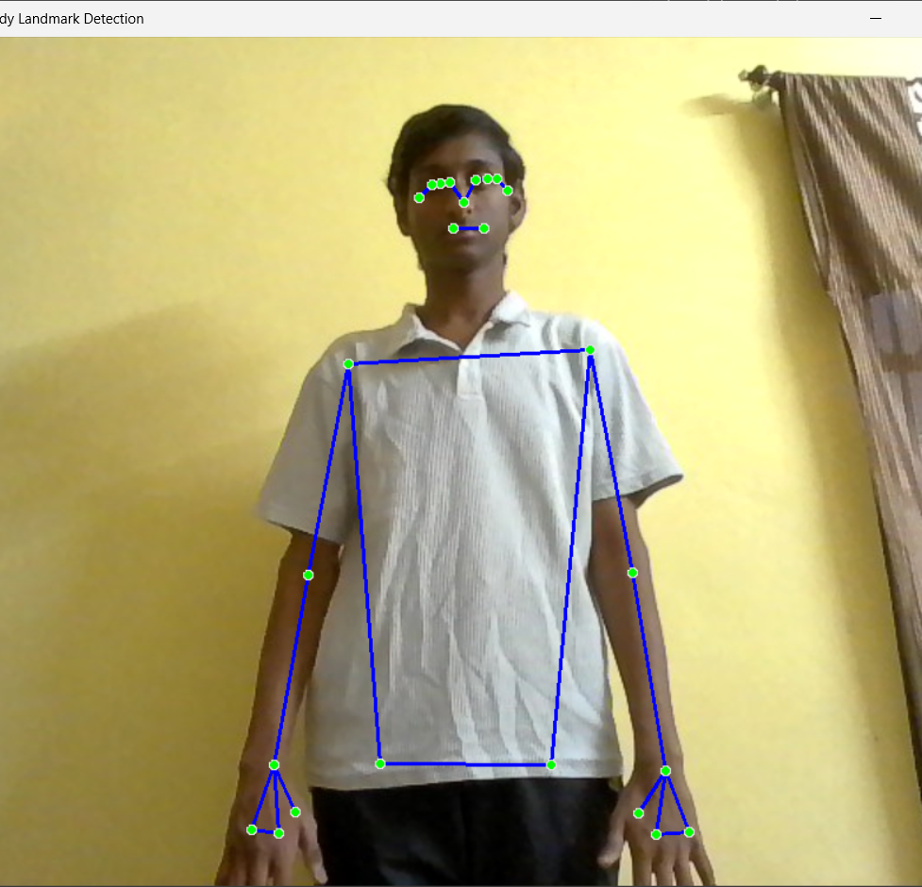
Computer Vision in Fashion AI
Computer Vision enables machines to understand and analyze images.
Applications
Human Detection
Body Segmentation
Pose Estimation
Landmark Detection
Background Removal
Image Processing

Slide 7
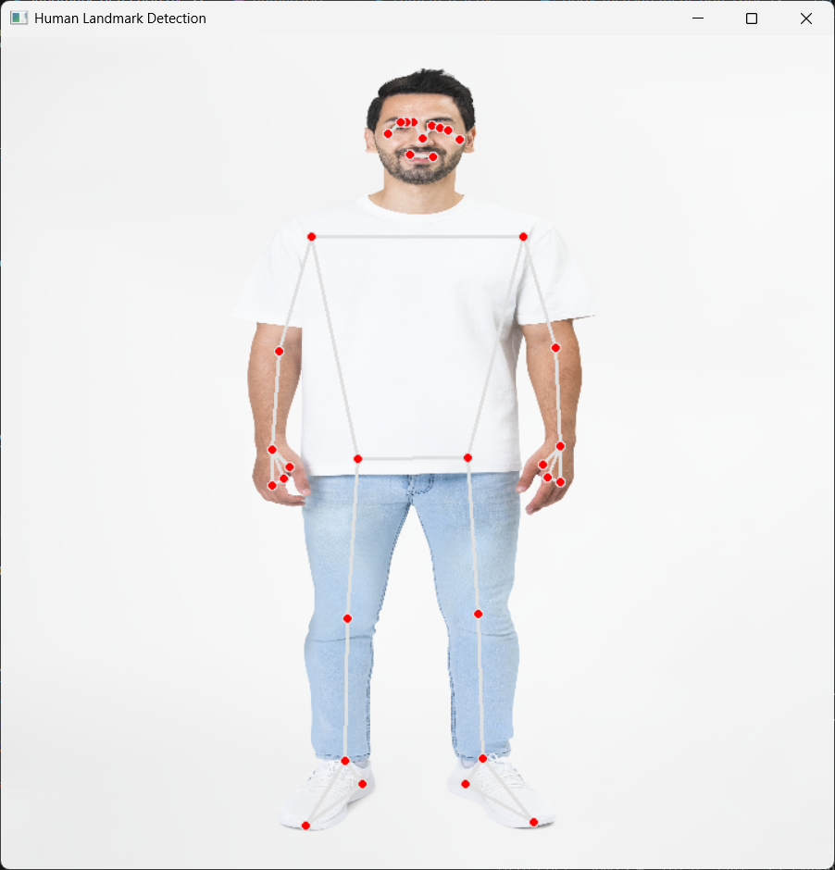
Pose Estimation
Human Pose Estimation
Pose estimation identifies body joints and key points.
Models Studied
MediaPipe Pose
OpenPose
Advantages
Real-time processing
High accuracy
Landmark extraction

Slide 8
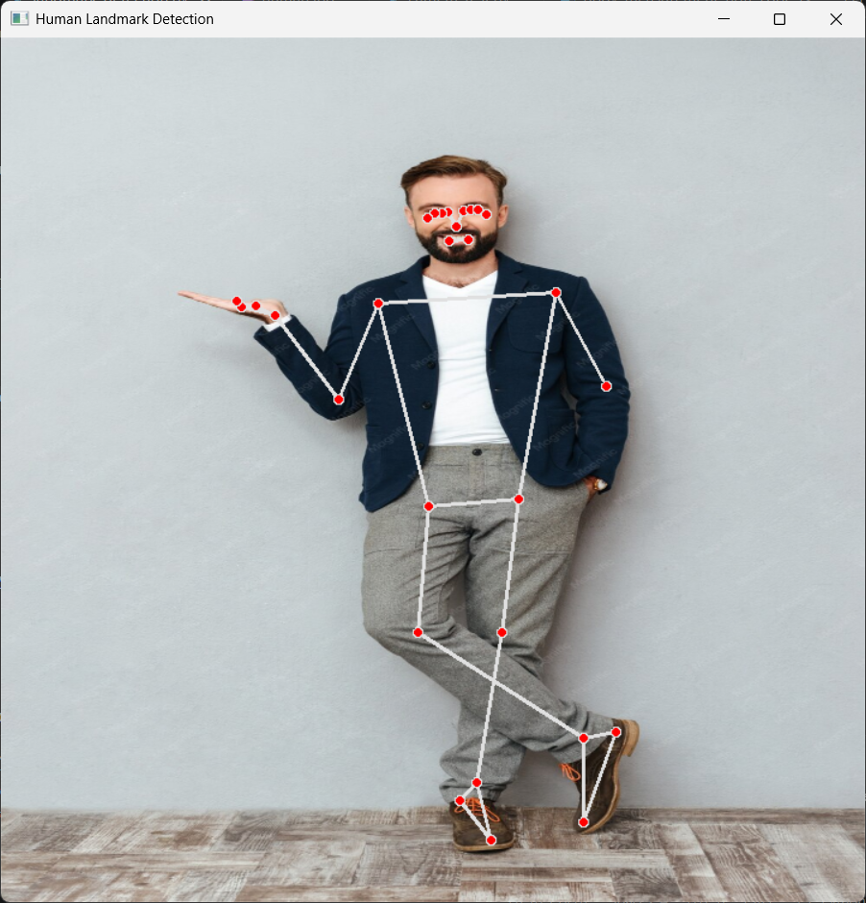
Body Landmark Detection
Body landmarks are used to locate important body points.
Major Landmarks
Shoulders
Elbows
Wrists
Hips
Knees
Ankles
Applications
Body Measurement
Garment Alignment
Virtual Try-On

Slide 9
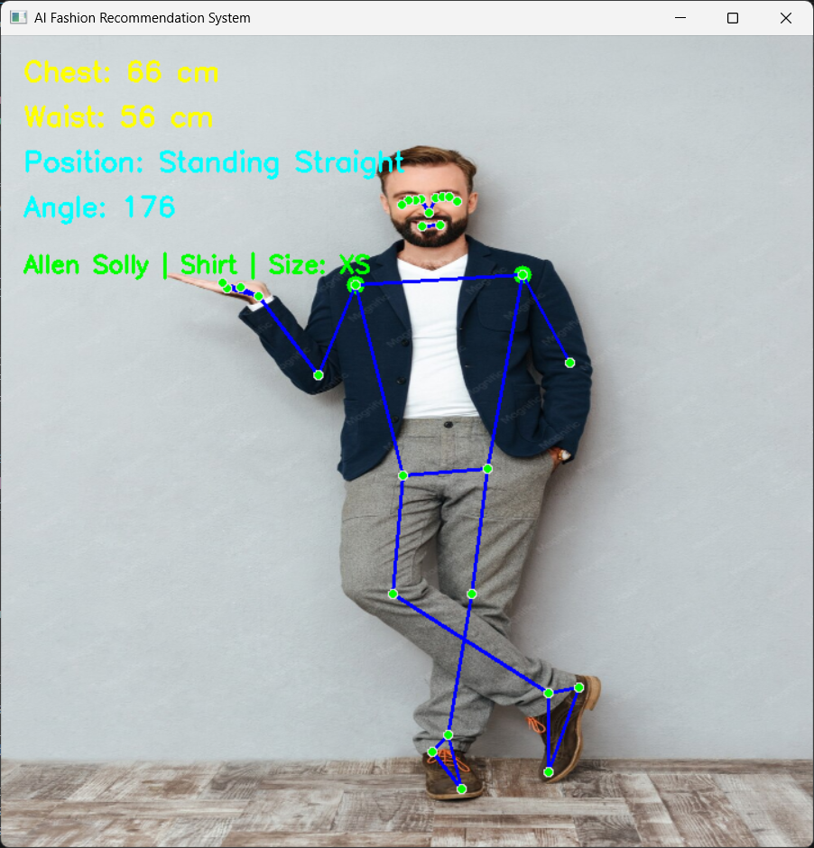
Body Measurement Extraction
Workflow
Input Image
↓
Pose Detection
↓
Landmark Extraction
↓
Distance Calculation
↓
Measurement Estimation

Slide 10
Fashion Datasets
Dataset | Purpose
DeepFashion | Fashion Recognition
DeepFashion2 | Landmark Detection
VITON | Virtual Try-On
VITON-HD | High Resolution
Dress Code | Multi-category Clothing
Fashionpedia | Fashion Attributes

Slide 11
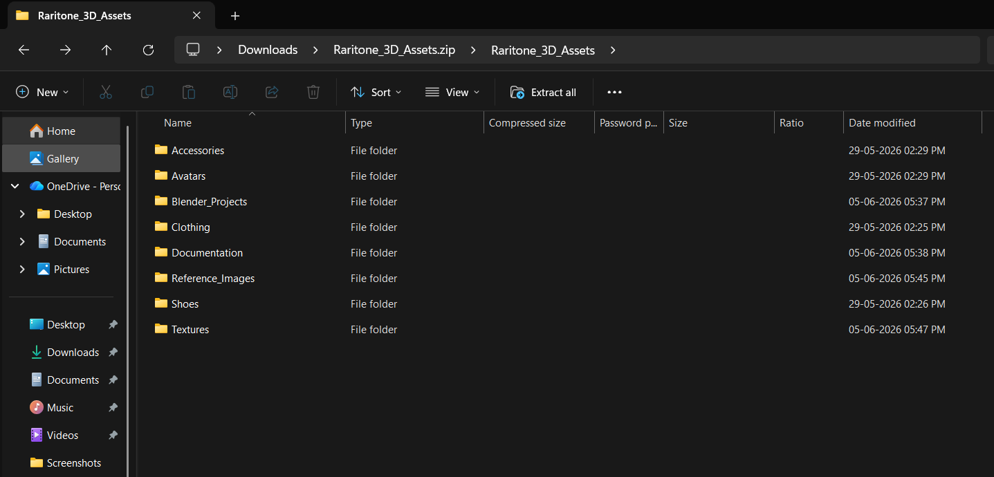
Dataset Preparation
Dataset Preparation
Data Collection
Data Cleaning
Metadata Generation
Annotation
Training / Validation Split
Dataset Organization
Dataset quality directly affects AI model performance.

Slide 12
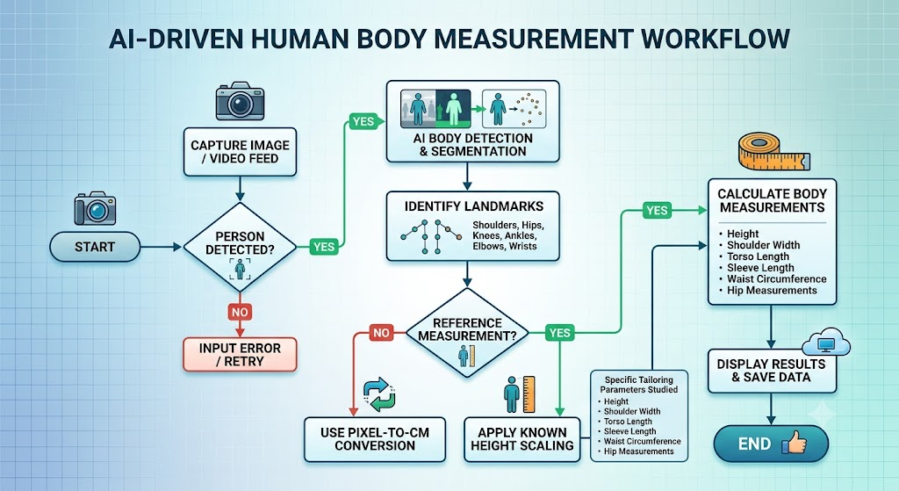
AI-Based Virtual Try-On
Virtual Try-On systems allow users to digitally wear garments before purchasing.
Components
Human Detection
Segmentation
Pose Estimation
Garment Processing
Image Generation

Slide 13
2D Virtual Try-On Models
Model | Strength
VITON | Basic Try-On
CP-VTON | Better Alignment
HR-VITON | High Resolution
StableVITON | Diffusion Model
IDM-VTON | Identity Preservation

Slide 14
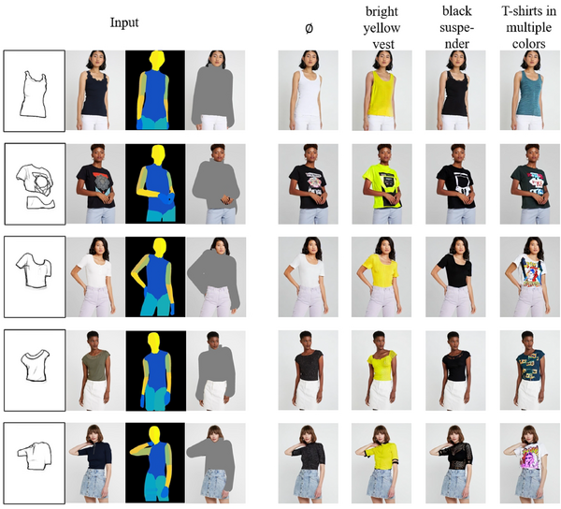
Garment Warping
Garment Warping Techniques
Thin Plate Spline (TPS)
Smooth transformation
Landmark based
Geometric Matching Module (GMM)
Deep Learning approach
Better garment fitting
Flow-Based Warping
Texture preservation

Slide 15
AI-Based Cloth Blending
Techniques
Alpha Blending
Image Composition
Edge Smoothing
Benefits
Natural appearance
Better garment integration
Improved realism

Slide 16
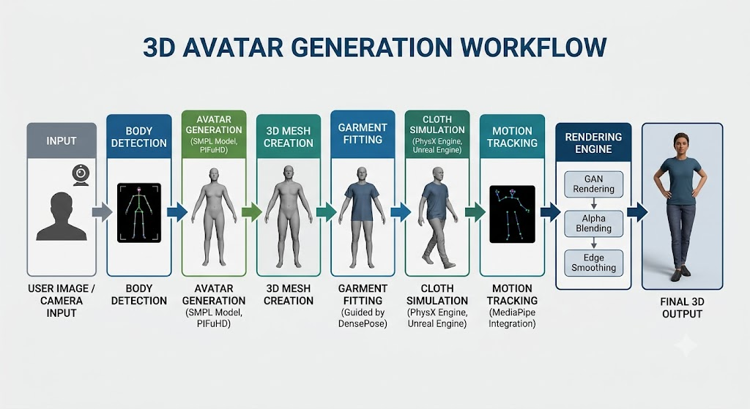
3D Avatar Generation
Models Studied
SMPL
PIFuHD
ICON
HumanNeRF
3D Gaussian Splatting

Slide 17
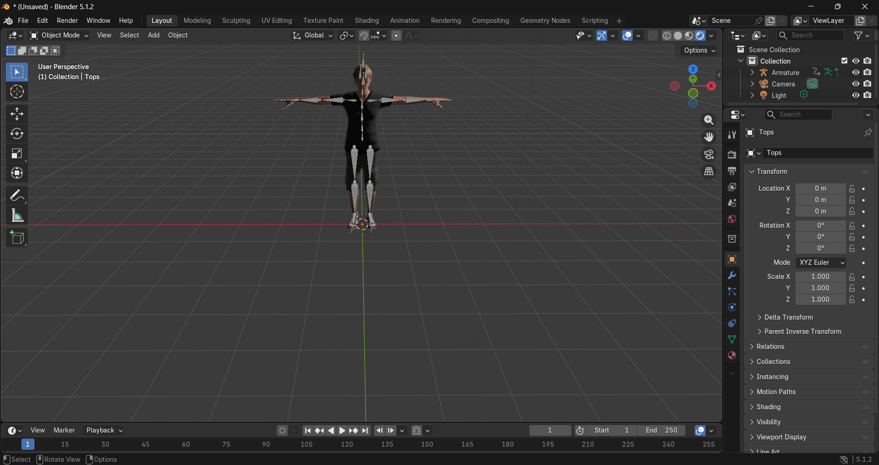
Cloth Simulation
Cloth Simulation Technologies
Unity Cloth
NVIDIA PhysX
Marvelous Designer
Blender Cloth Simulation
Applications
3D Fashion
Avatar Animation
Digital Clothing

Slide 18
AI Recommendation Systems
Content-Based Filtering
Collaborative Filtering
Hybrid Recommendation
Deep Learning Recommendation
Purpose:
Generate personalized outfit suggestions.

Slide 19
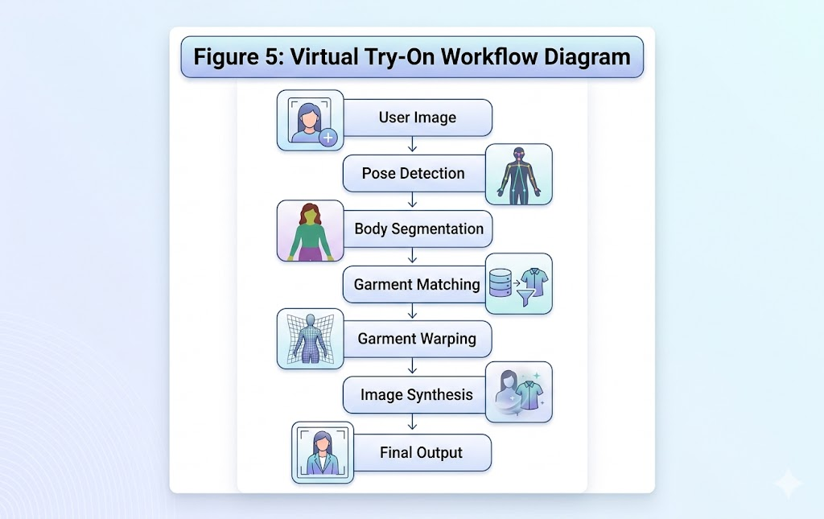
AI Recommendation Workflow
Recommendation Pipeline
User Registration
↓
Preference Collection
↓
Body Measurements
↓
Recommendation Engine
↓
Outfit Ranking
↓
Final Suggestions

Slide 20
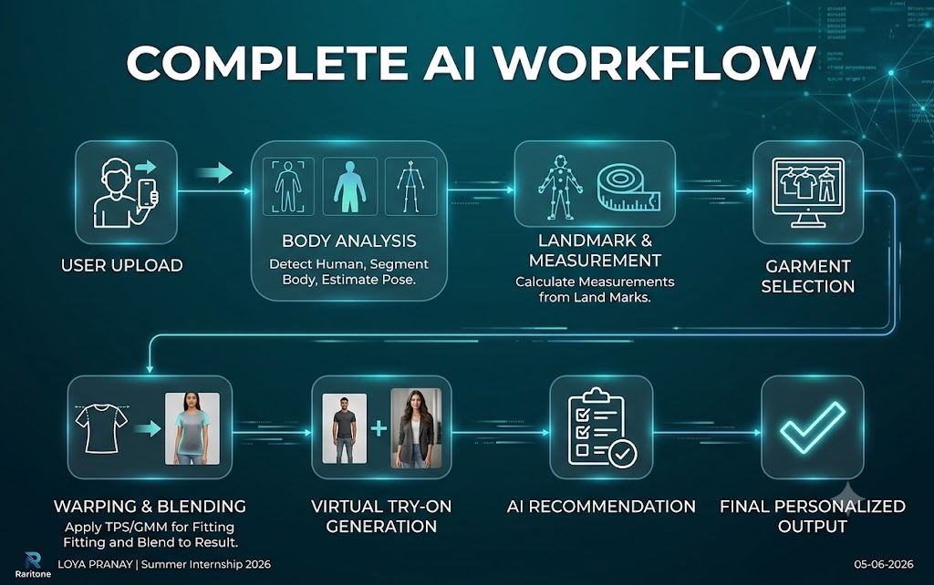
Complete AI Workflow
User Upload
↓
Body Analysis
(Human Detection + Segmentation + Pose Estimation)
↓
Landmark & Measurement Extraction
↓
Garment Selection
↓
TPS / GMM Warping
↓
Cloth Blending
↓
Virtual Try-On Generation
↓
AI Recommendation Engine
↓
Final Personalized Output

Slide 21
Challenges Faced
Understanding Virtual Try-On systems.
Learning advanced AI models.
Dataset organization.
Garment warping concepts.
3D avatar generation.
Hardware limitations.
Managing multiple research topics.

Slide 22
Solutions Applied
Independent learning.
Research paper analysis.
Comparative studies.
Workflow-based understanding.
Structured documentation.
GitHub organization.
Modular learning approach.

Slide 23
Skills Developed
Technical Skills
Artificial Intelligence
Computer Vision
Machine Learning
OpenCV
MediaPipe
GitHub
Technical Documentation
Professional Skills
Research
Problem Solving
Analytical Thinking
Independent Learning

Slide 24
Key Learnings
AI-powered Virtual Try-On workflow.
Body segmentation and landmark detection.
Body measurement extraction.
Fashion datasets and annotations.
Garment warping techniques.
AI recommendation systems.
3D avatar generation.

Slide 25
Future Improvements
Real-time Virtual Try-On.
Mobile application deployment.
Full 3D avatar support.
Diffusion-based AI models.
Personalized recommendation engines.
Multi-angle garment visualization.
Large-scale fashion datasets.

Slide 26

Conclusion
The AI/ML Internship provided valuable exposure to Artificial Intelligence, Computer Vision, and modern fashion technologies.
The project explored body segmentation, pose estimation, body measurement extraction, Virtual Try-On systems, garment warping, recommendation engines, and 3D avatar generation.
The internship strengthened technical knowledge, research methodology, documentation skills, and problem-solving abilities while providing a strong foundation for future work in AI-powered fashion and intelligent digital systems.

Slide 27
Thank You
I would like to express my sincere gratitude to Raritone for providing me with the opportunity to be a part of the Summer Internship 2026 as an AI/ML Intern.
I am thankful to the entire team and mentors for their guidance, support, and encouragement throughout this journey.
Thank You for Giving Me This Wonderful Opportunity.
LOYA PRANAY

